Slide 1
Final projects: Tutorial of Seurat

Slide 2
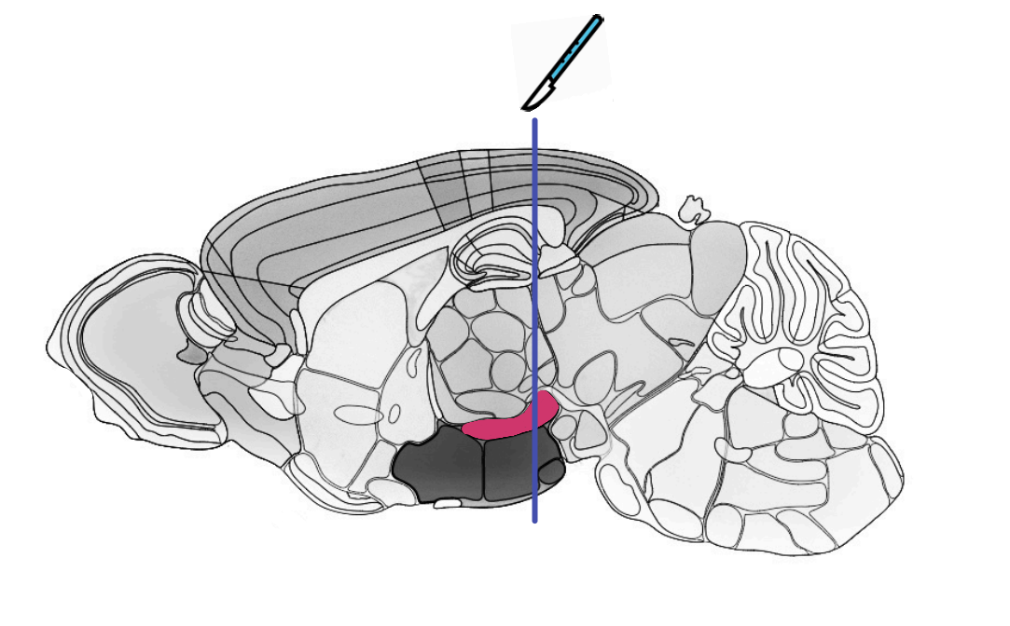
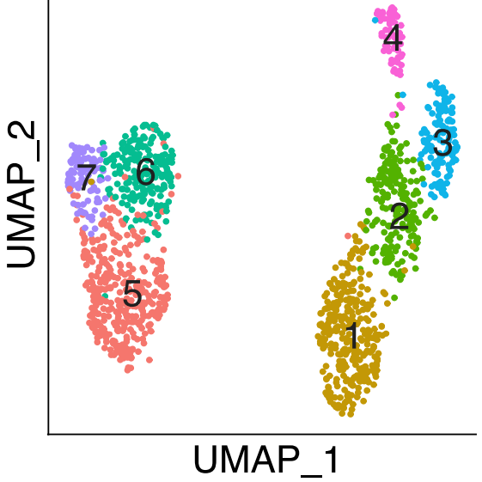
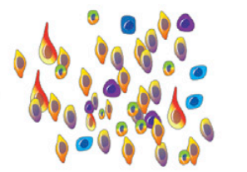
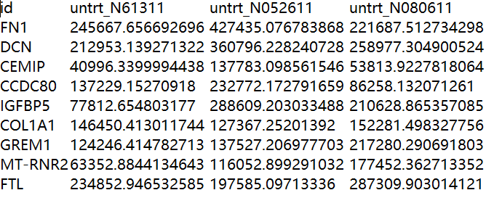
Procedure of snRNA analysis
Dissecting region of interest
Isolation of nuclei
Seurat
10Xgenomics seq
Isolated nuclei
Pollen, A. A. et al. (2015) Cell. Elsevier Inc., 163(1), pp. 55–67.
Zhang, C. et al. (2021) Neuron. Elsevier Inc., 109(3), pp. 461-472.

Slide 3
Raw DATA presentation
2020.07.09 P40 X 1
cell number：11008； features counts：23504
2020.06.06 P40 X 1
cell number：7923； features counts：23268

Slide 4
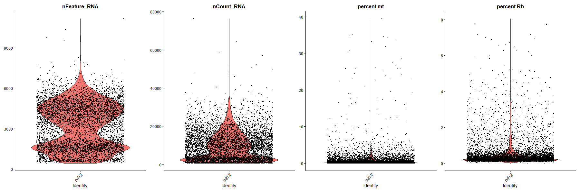
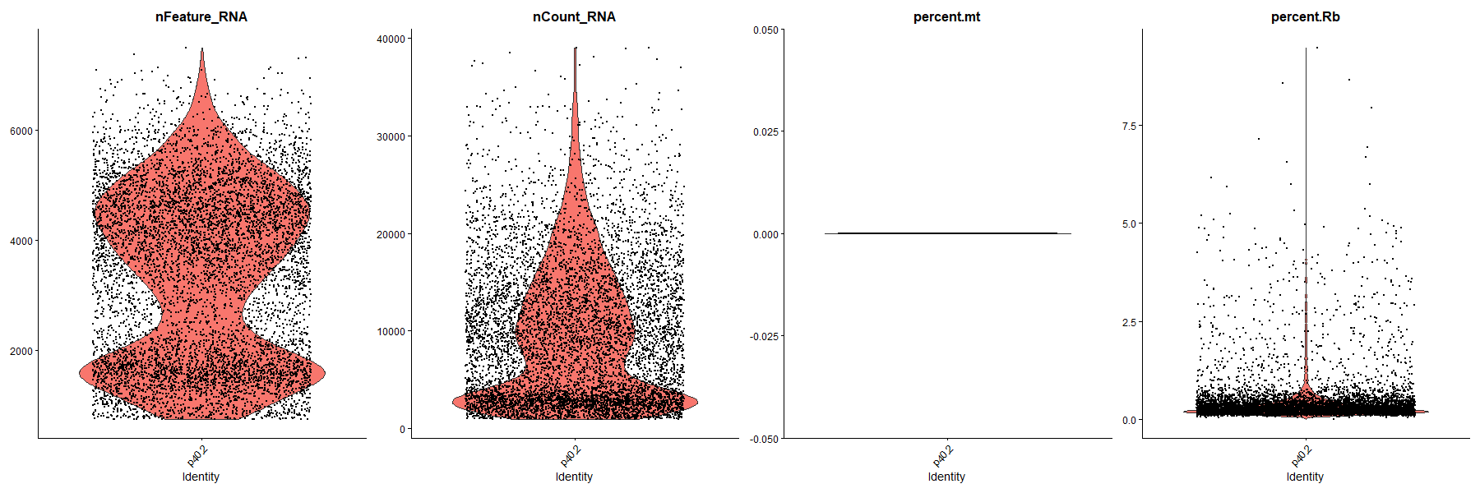
Quality Control（P40_20200606）
nFeature_RNA<7500
2. nCount_RNA<40000
3. mtRNA is removed

Slide 5
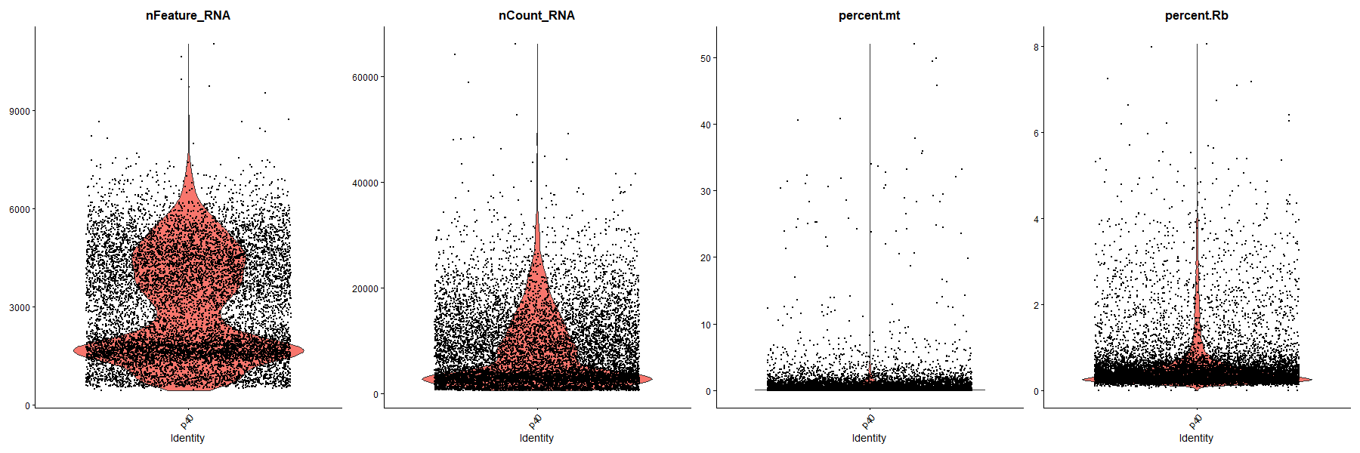
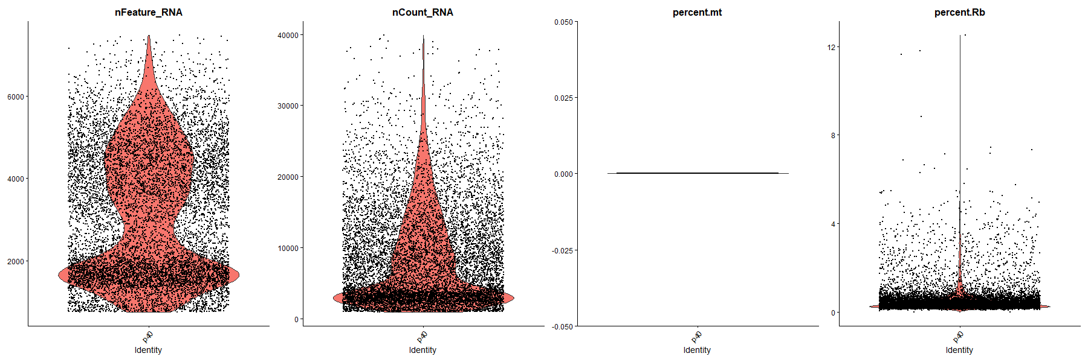
Quality Control（P40_20200709）
nFeature_RNA<7500
2. nCount_RNA<40000
3. mtRNA is removed

Slide 6
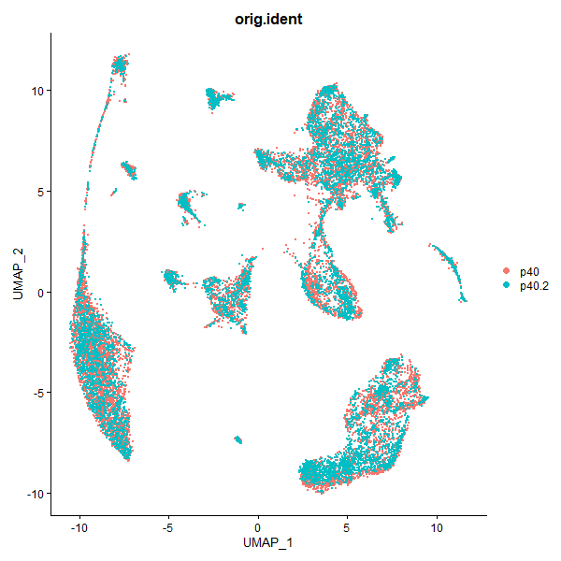
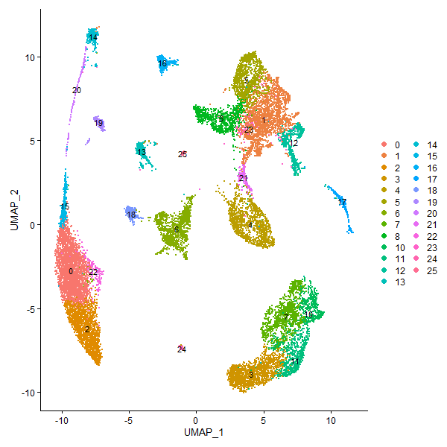
Data Integration by rpca（integration）

Slide 7
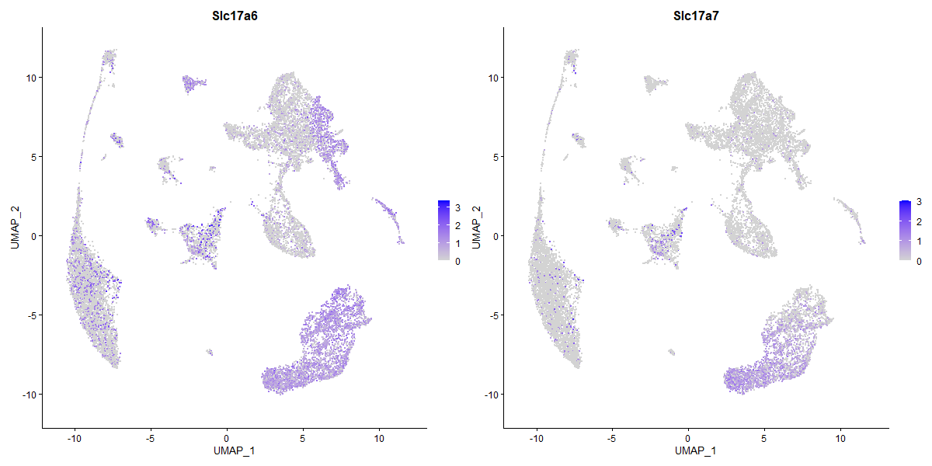
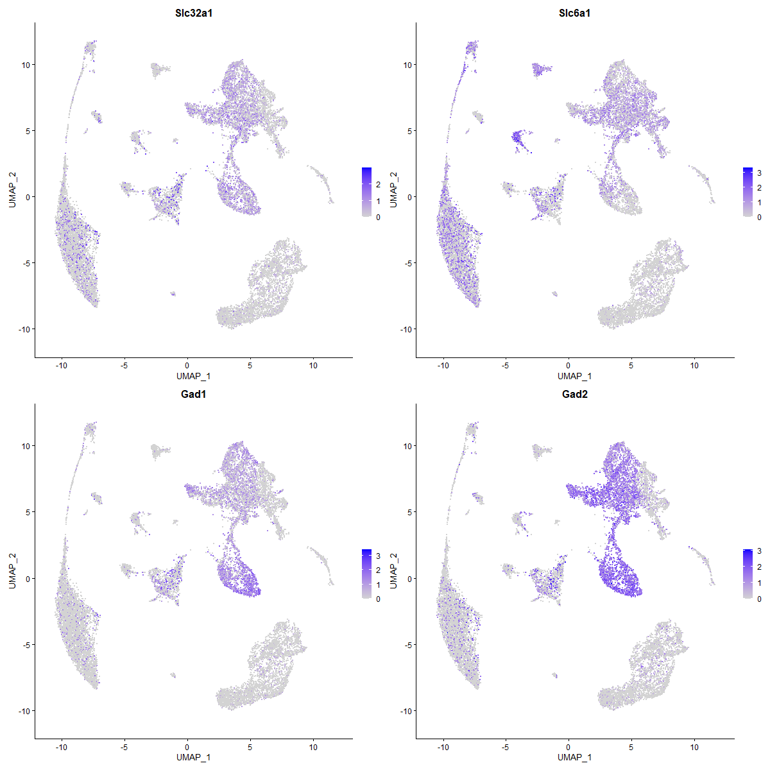
Identifying clusters with specific cell type markers
Excitatory neurons
Inhibitory neurons
Slc17a6
Slc17a7
Gad2
Slc32a1

Slide 8
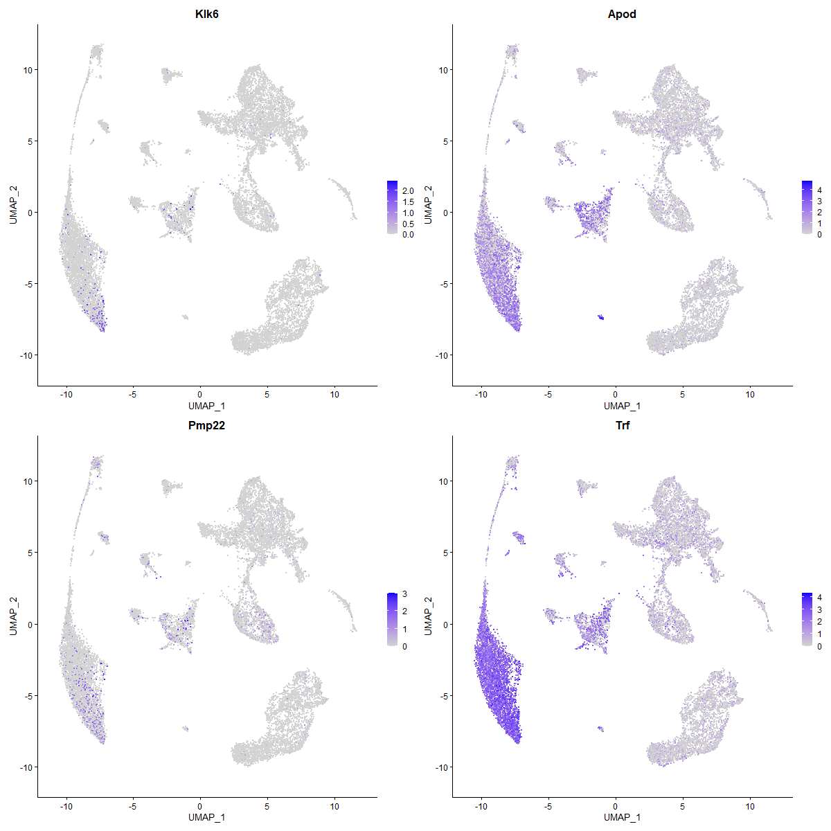
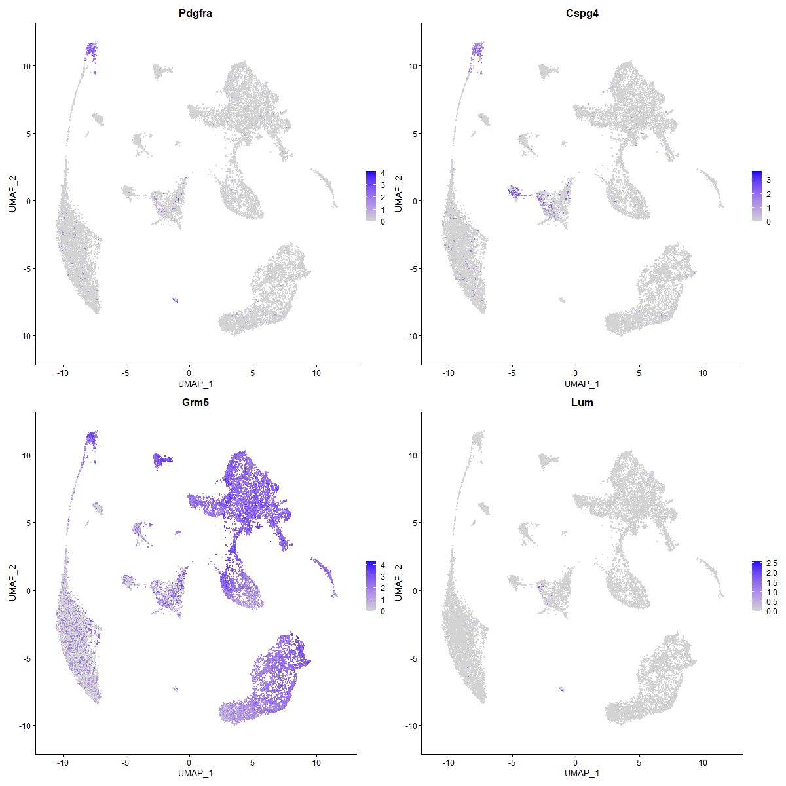
Identifying clusters with specific cell type markers
Mature oligodendrocytes
Oligodendrocyte precursor cells (Cspg4+)
vascular and leptomeningeal cells (Cspg4-)
Apod
Trf
Pdgfra
Cspg4

Slide 9
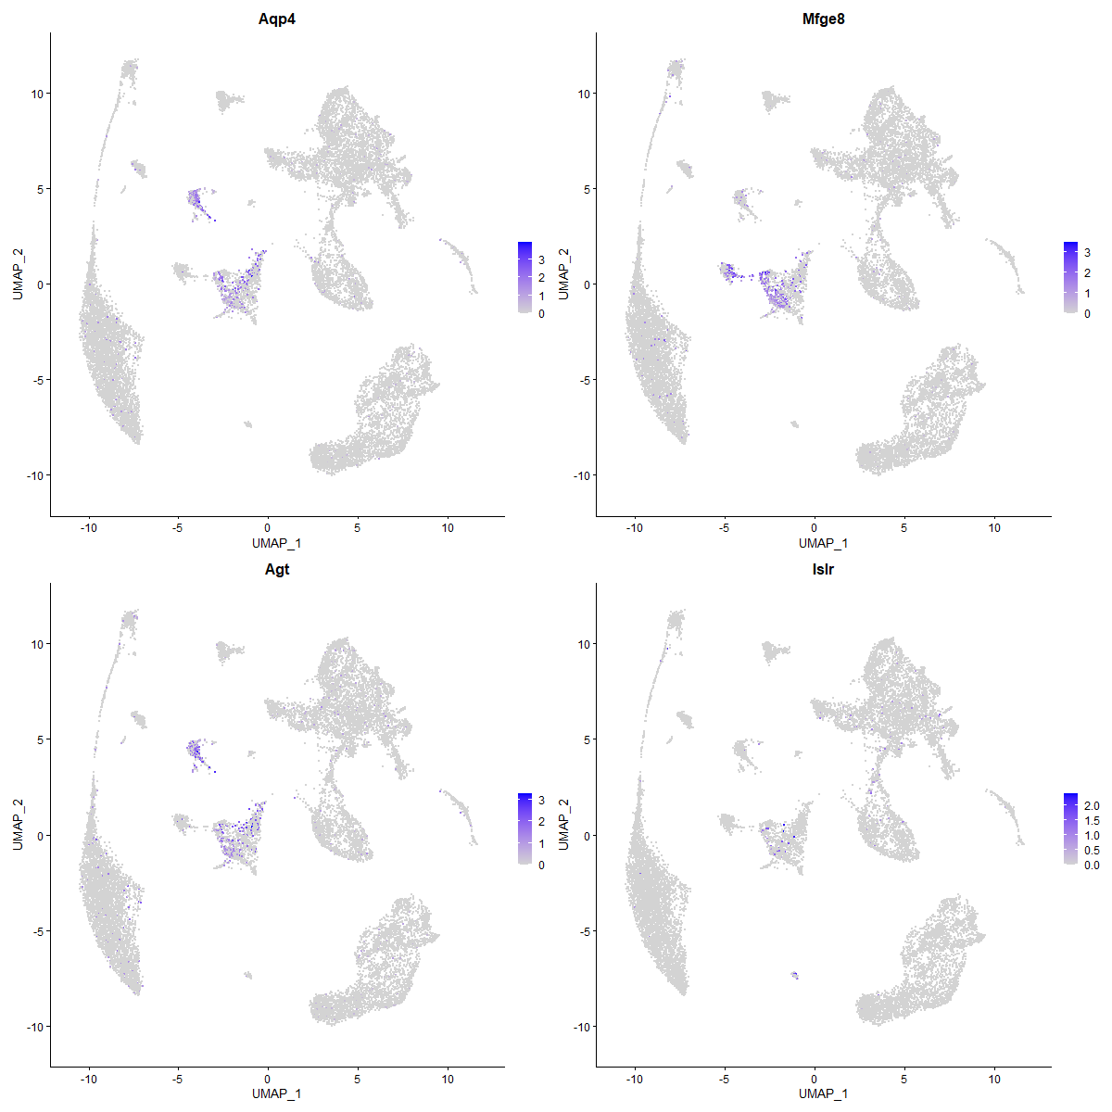
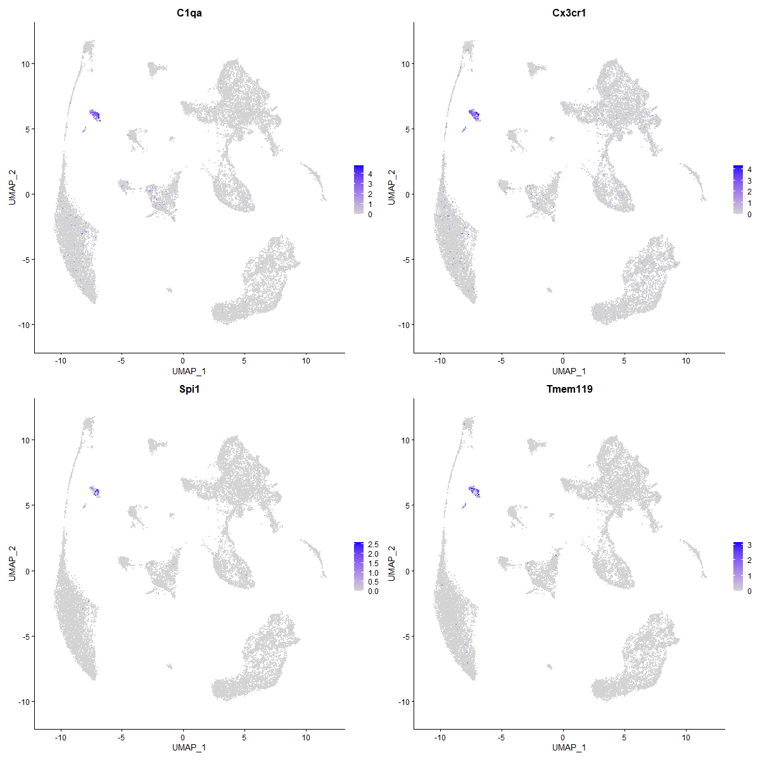
Identifying clusters with specific cell type markers
Astrocyte
Microglia
Aqp4
Agt
C1qa
Cx3cr1

Slide 10
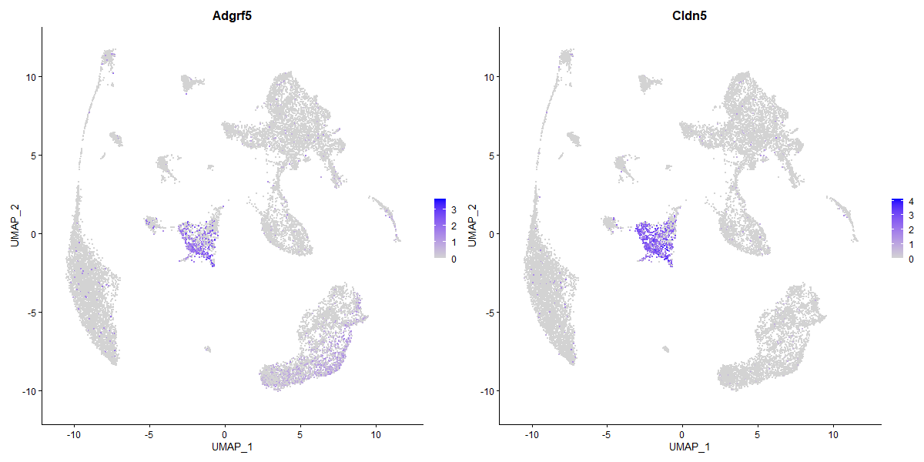
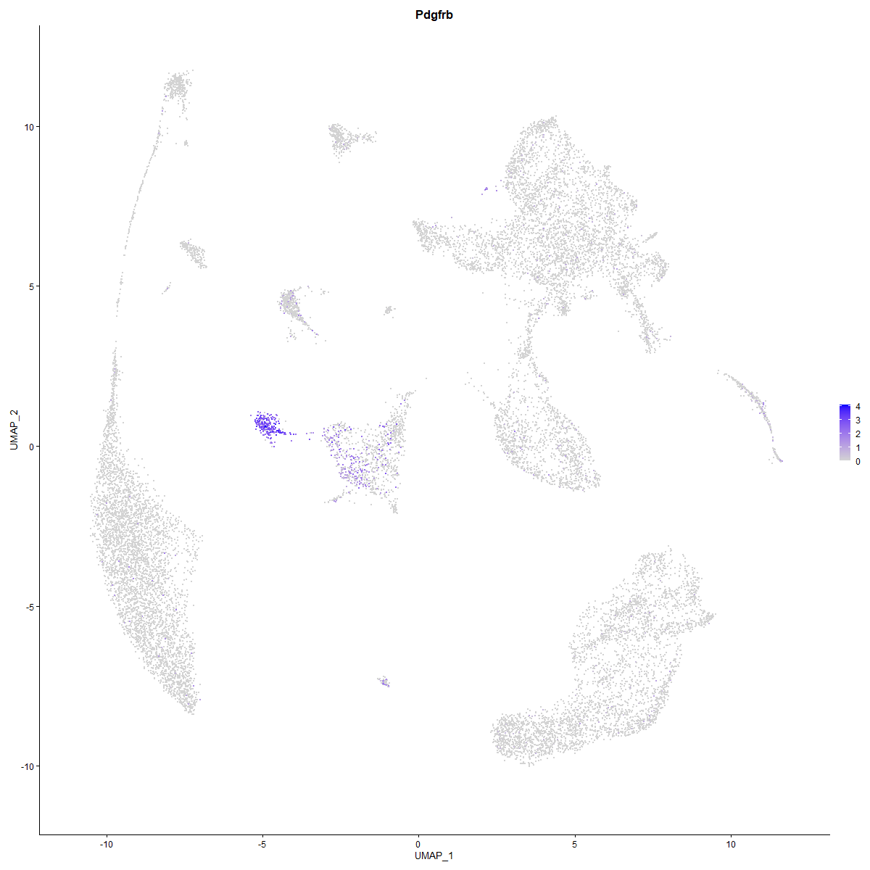
Identifying clusters with specific cell type markers
Endothelial cells
Pericytes
Adgrf5
Cldn5
Pdgfrb

Slide 11
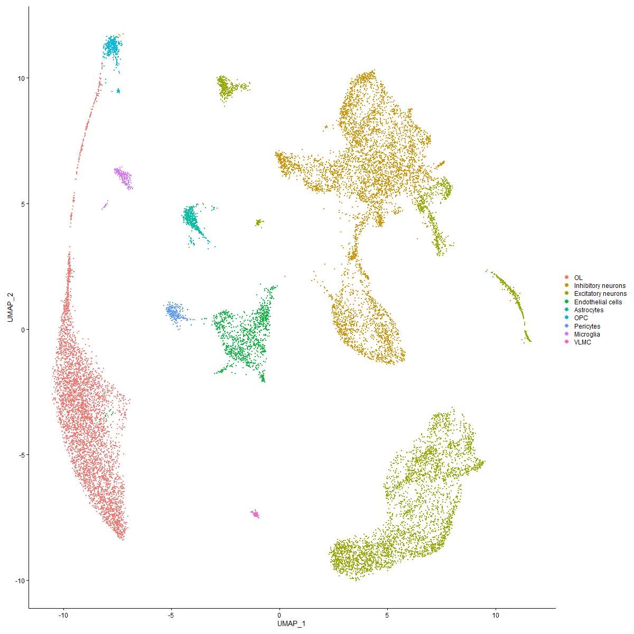
Cell atlas visualization by UMAP
Focus more on neuron clusters
Inhibitory neurons
Excitatory neurons

Slide 12
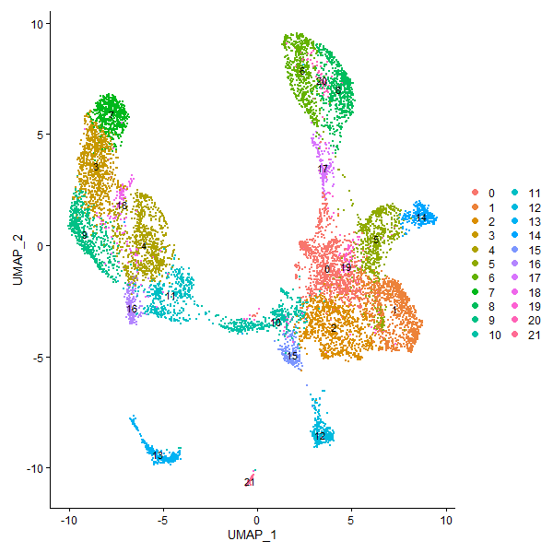
Re-clustering of neuron clusters by PCA
Blue: inhibitory neuron； Red: excitatory neuron
2. UMAP plot：resolution = 1，PCA = 30
3. We focused more on inhibitory neurons

Slide 13
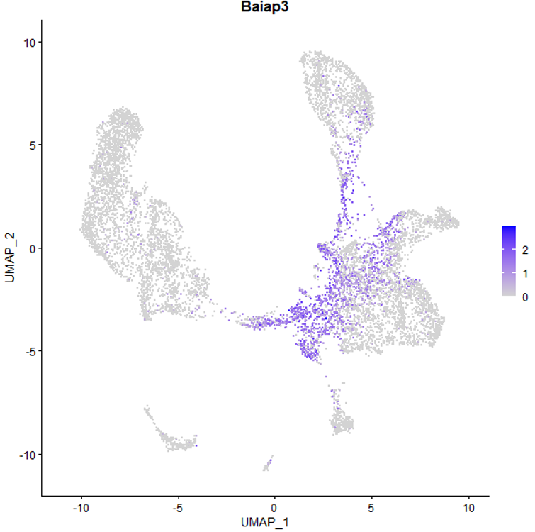
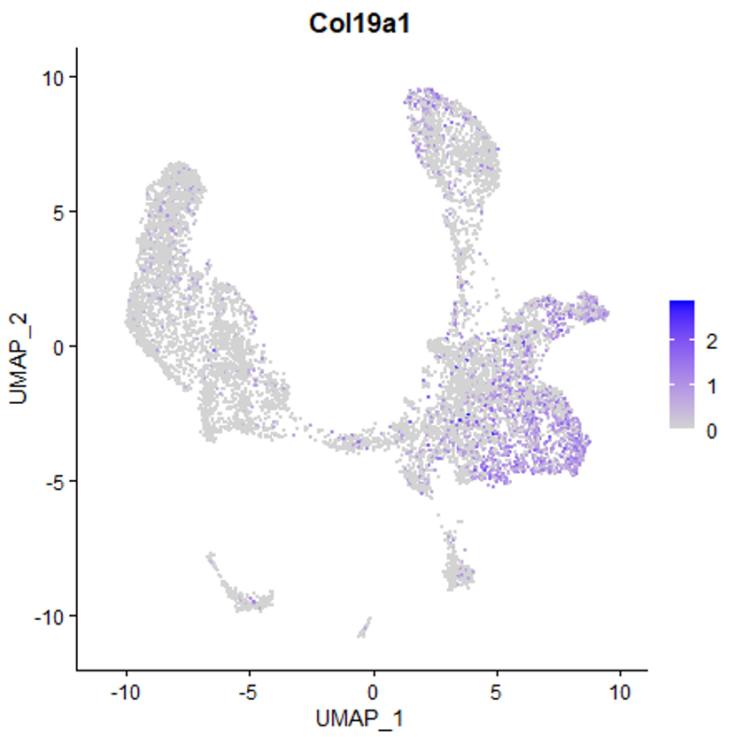
Cluster 0, 1: GABAnergics in HY/ZI

Slide 14
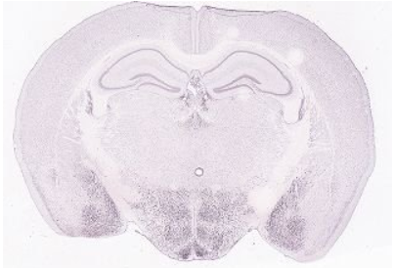
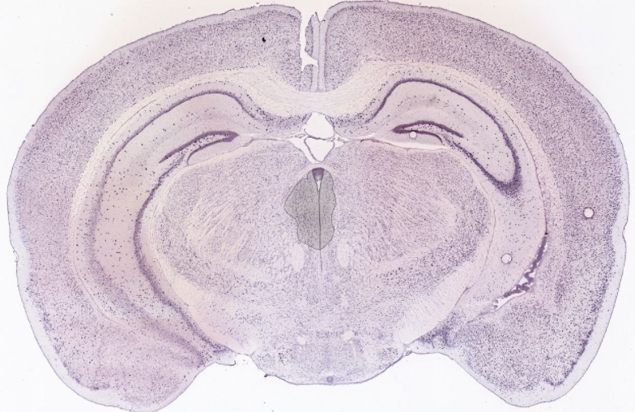
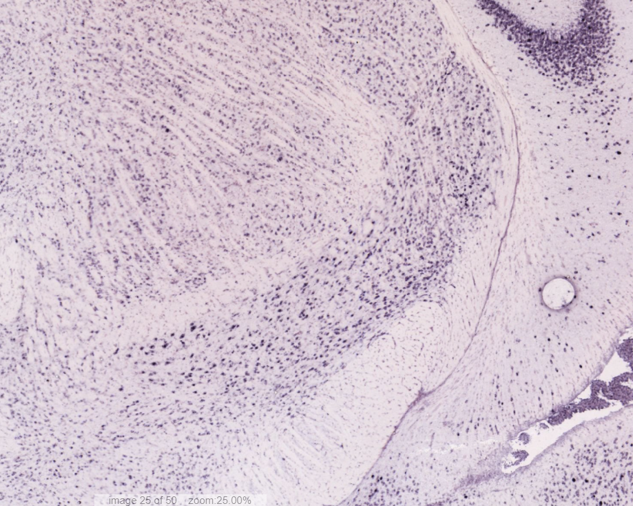
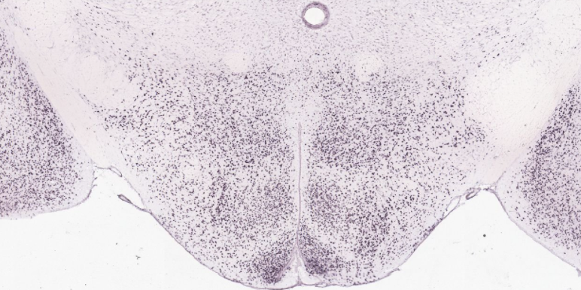
Verification by ISH staining data bank from allen brain
Baiap3
Col19a1

Slide 15
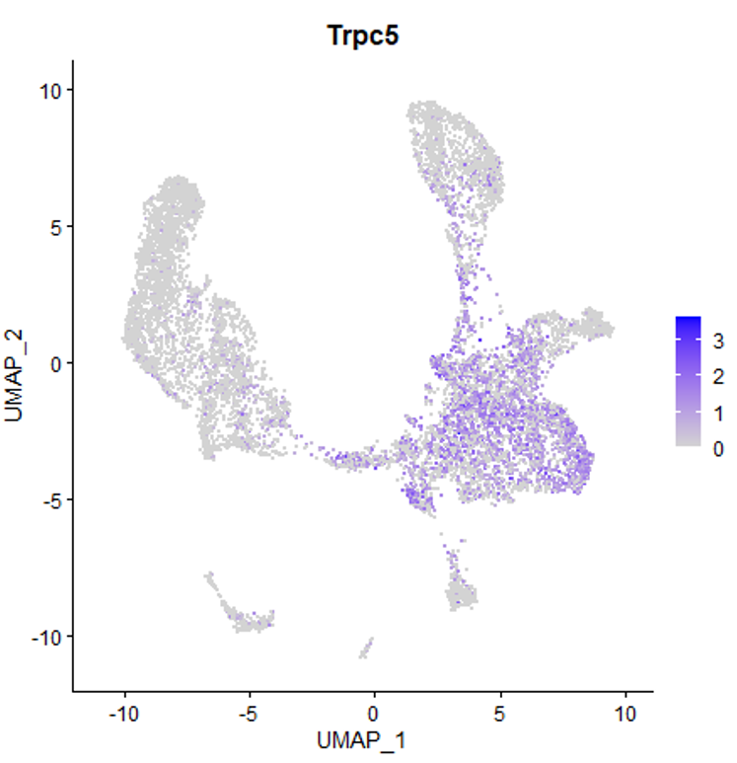
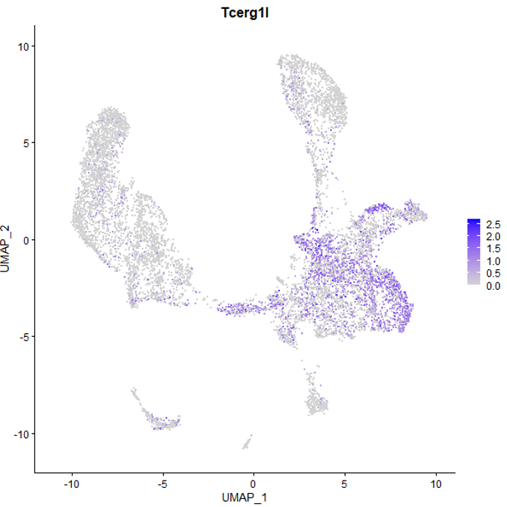
Cluster 0, 1: GABAnergics in HY/ZI

Slide 16
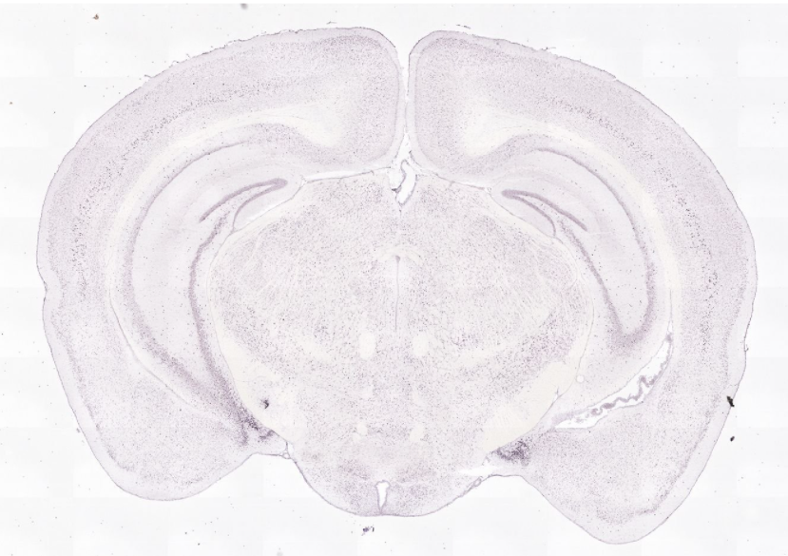
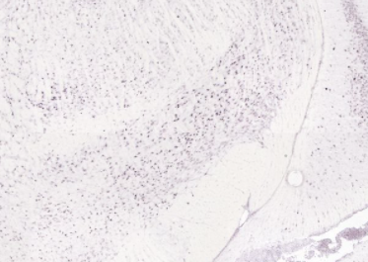
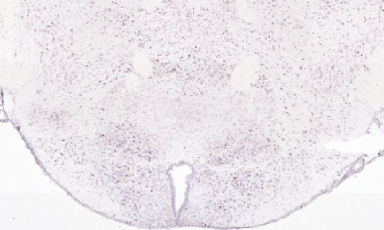
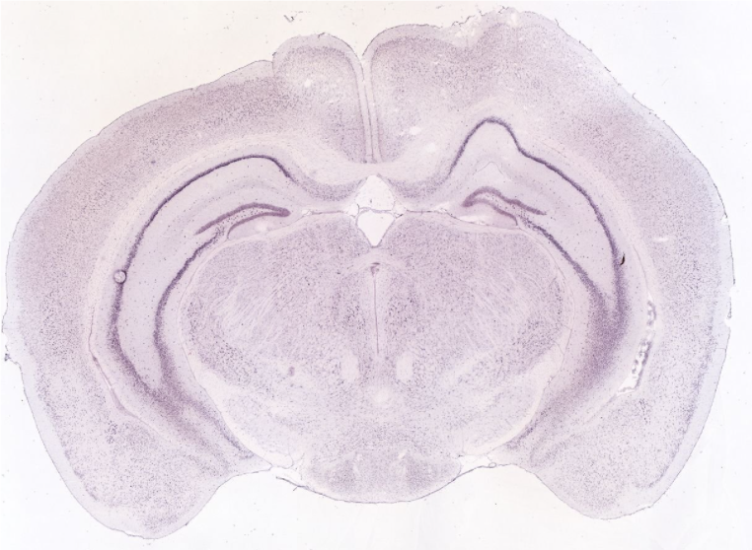
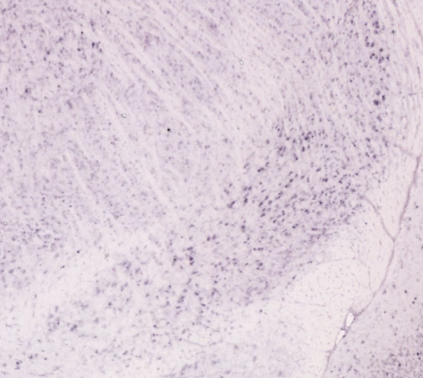
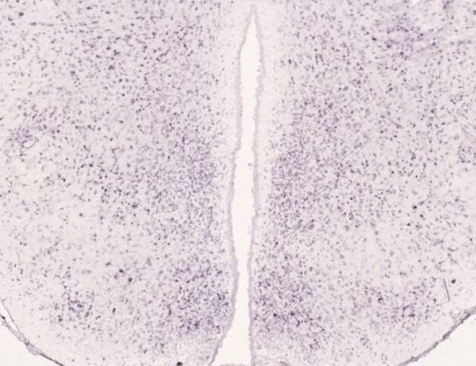
Verification by ISH staining data bank from allen brain
Tcerg1l
Trpc5

Slide 17
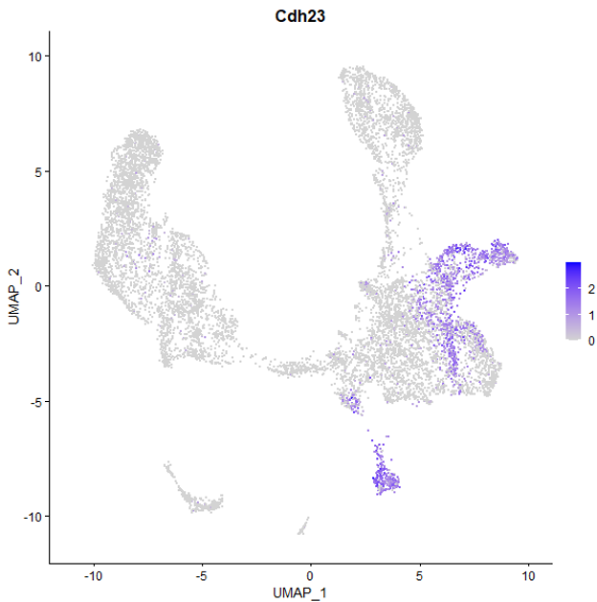
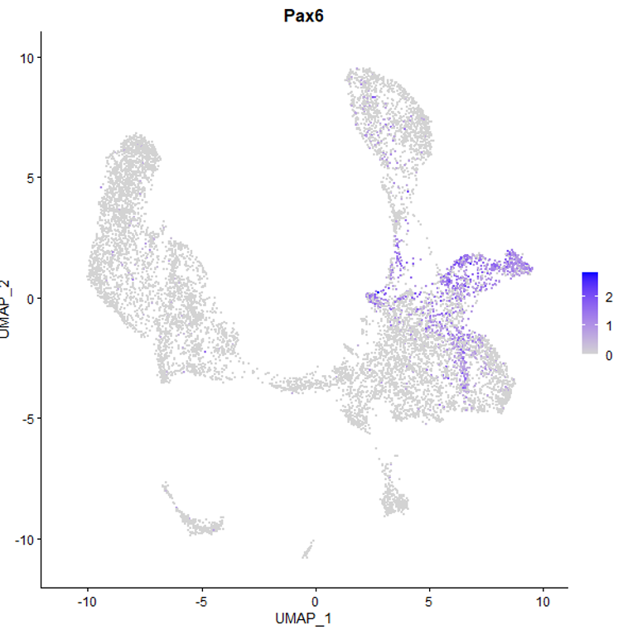
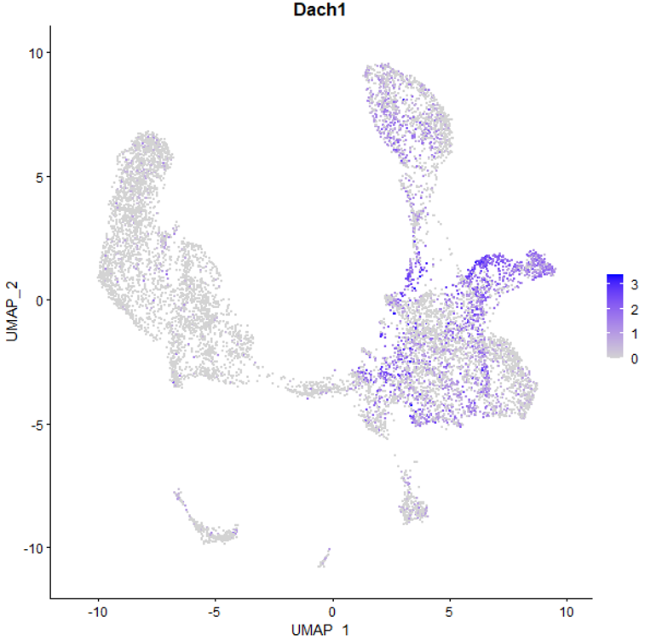
Cluster 5, 14: GABAnergics in ZI/STN

Slide 18
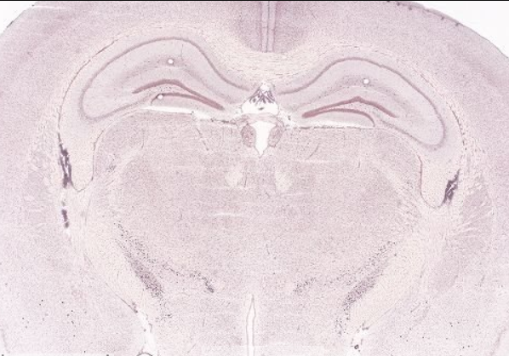
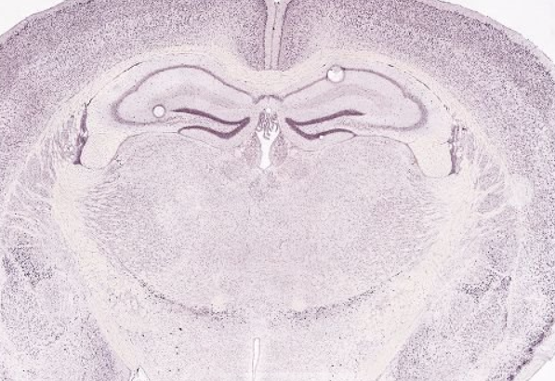
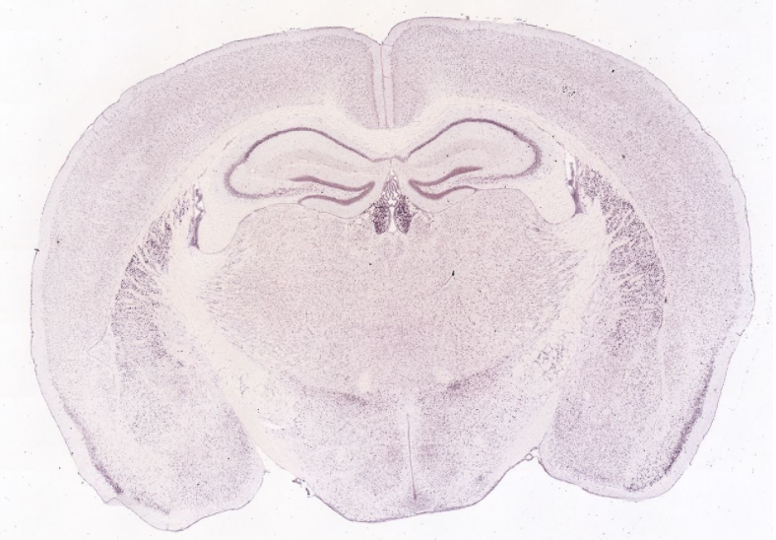
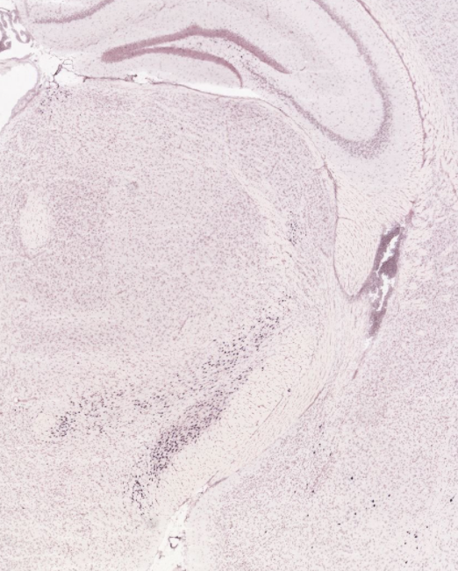
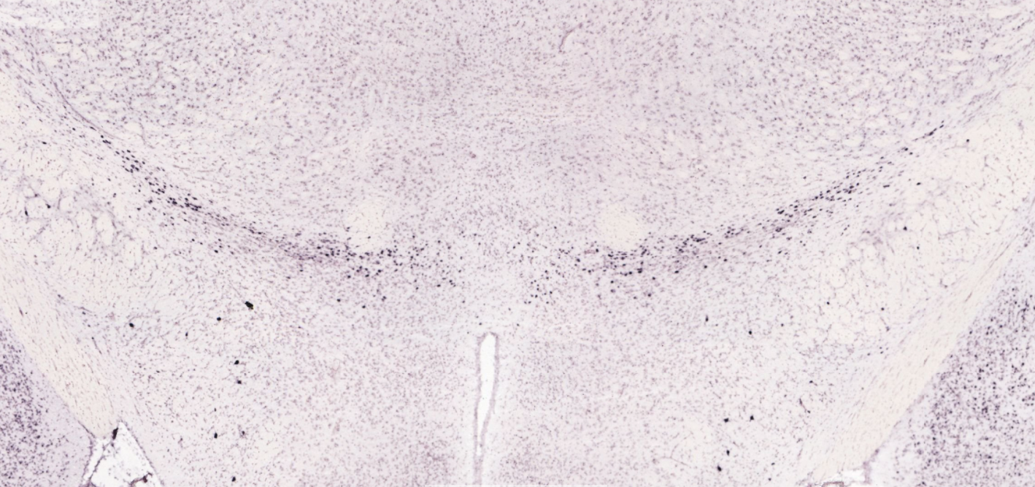
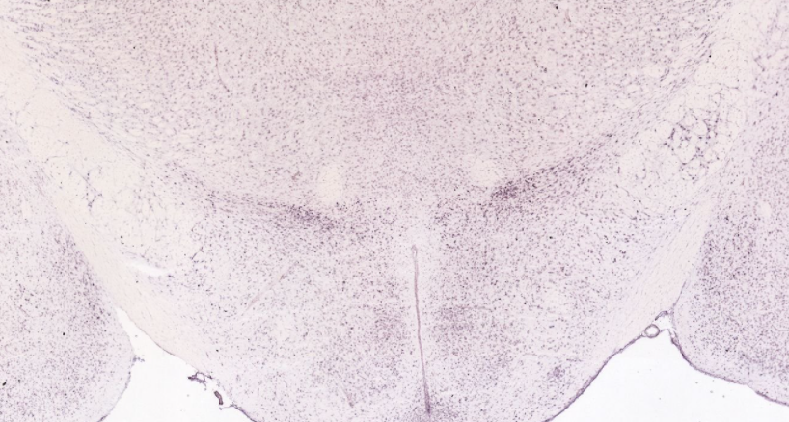
Cdh23 ZID/V
Pax6 ZID/V
Dach1

Slide 19
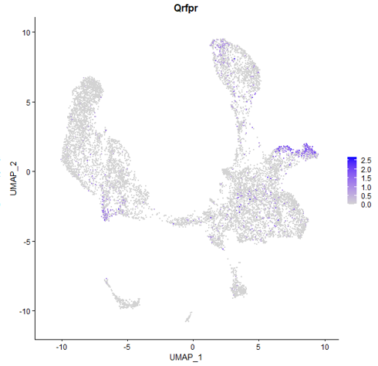
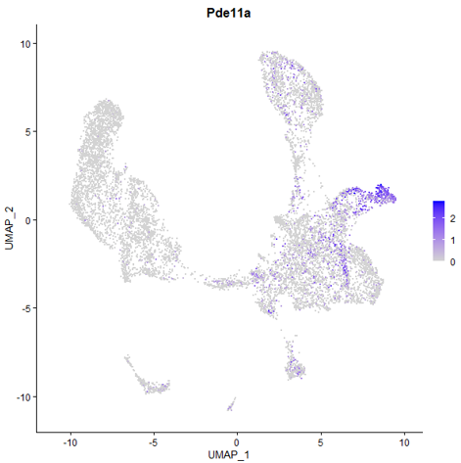
Cluster 5, 14: GABAnergics in STN

Slide 20
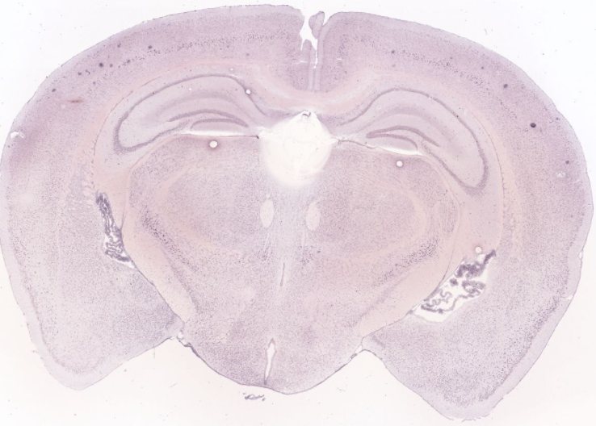
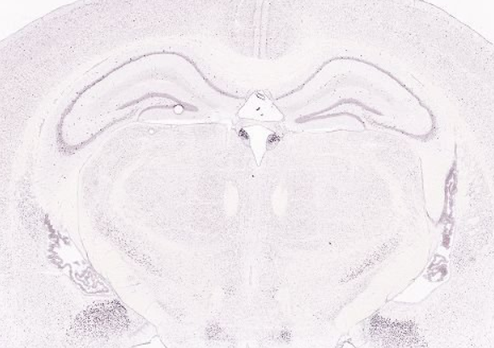
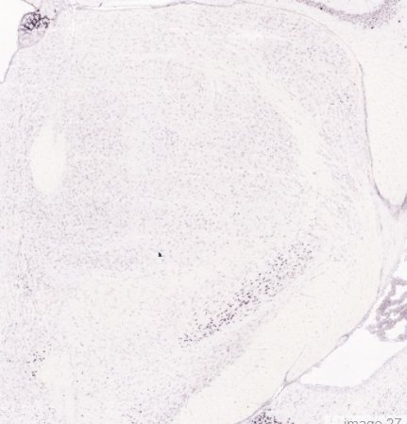
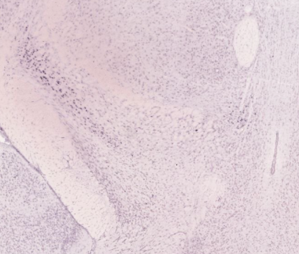
Qrfpr
Pde11a

Slide 21
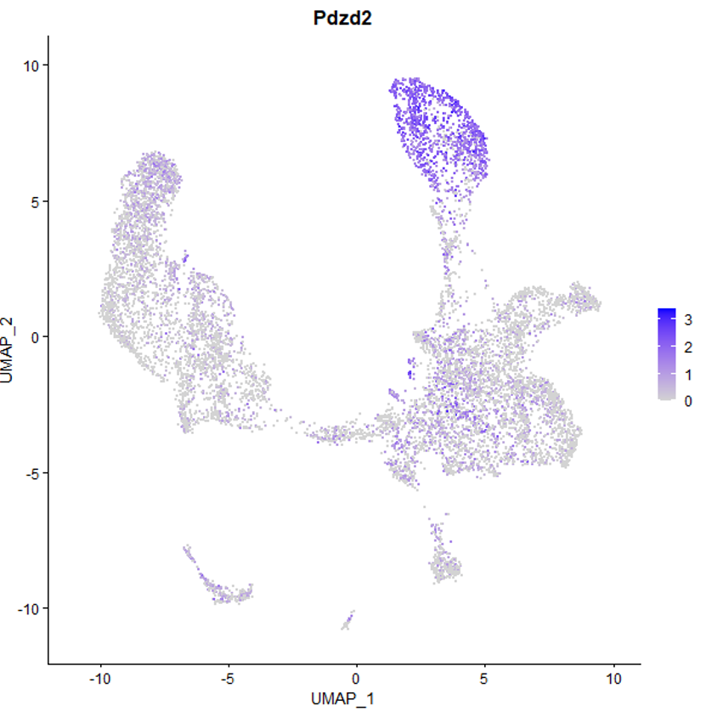


Cluster 6,8,20: GABAnergics in RT three markers: Pdzd2, Eepd1, Six3

Slide 22






Pdzd2
Six3
Eepd1

Slide 23



Cluster 17, 19: GABAnergics in ZI

Slide 24




Zeb2
Ubash3b

Slide 25


Ecel1

Slide 26
Summary
Inhibitory neuron cell clusters | Brain map distribution | Subcluster markers | Cluster markers
RT cluster | STN HY ZID/V | GABA_1: Hap1, Baiap3 | Tcerg1l
 |  | GABA_2: Col19a1
GABA_3+GABA_4+GABA_5 | RT STN ZID/V | GABA_3: Sema3e, Hmcn1 | Pdzd2, Six3, Eepd1
 |  | GABA_4: Zeb2 GABA_5: Gsn
GABA_6+GABA_7 | ZIR/D/V STN | GABA_6: Pde11a, Qrfpr, Cemlp | Pax6, Dach1, Gfra2, Cdh23
GABA_8 | ZIR/D/V RT HY | ONLY ONE CLUSTER | Ecel1
GABA_9 | ZIV STN | ONLY ONE CLUSTER | Aspa, Bcas1

